Slide 1
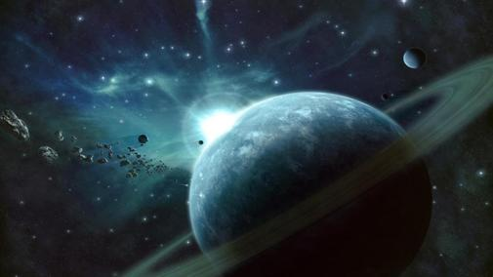
Neptune
By Robert

Slide 2
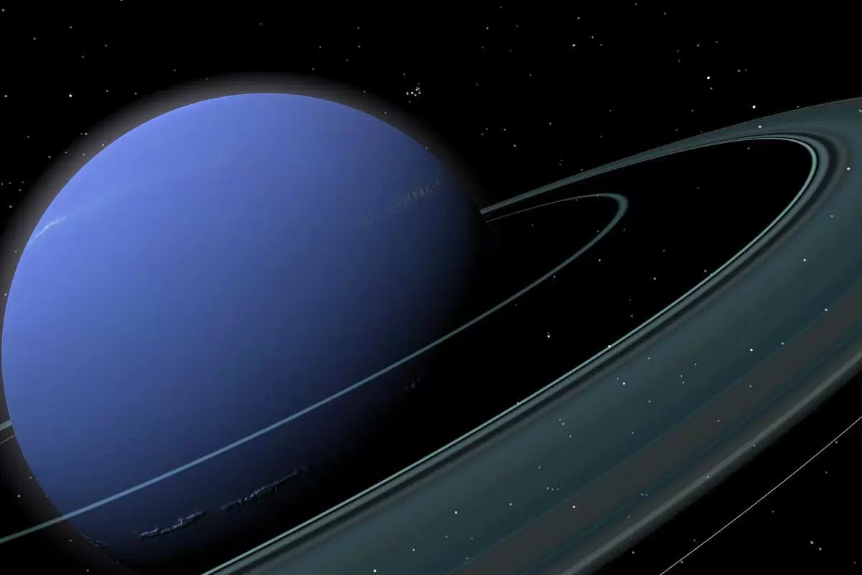
I chose Neptune because it has rings and it looks cool.
Neptune has 5 rings, they are made from small rocks and dust.

Slide 3
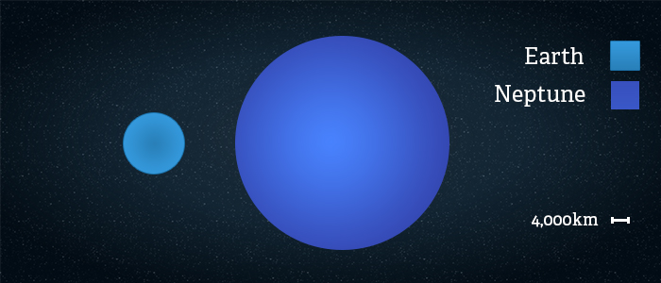
Size
Neptune’s mass is 102,000,000,000,000,000,000,000,000 kg
You could fit 57 Earths inside Neptune
Neptune is the third heaviest planet in the solar system

Slide 4
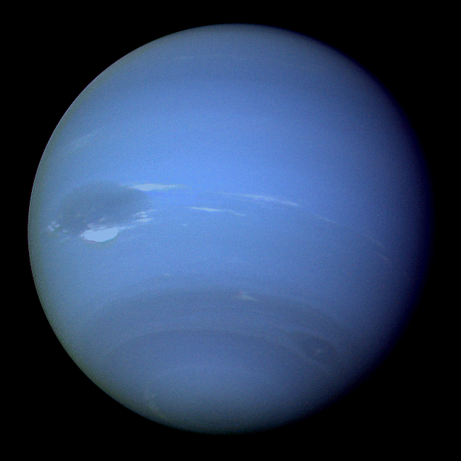
Weather
Neptune is the stormiest planet.
There was a huge storm on Neptune called the “Great Dark Spot” that lasted for 5 years.
Neptune is very very cold, it is -214°C.

Slide 5
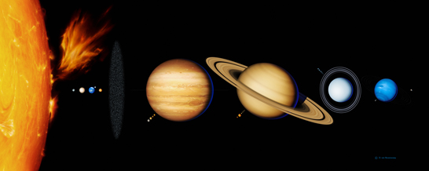
Neptune facts:
The 8th planet from the Sun
Has 14 Moons
Named after the Roman God of the Sea
Mostly made of gas, with a solid core

Slide 6
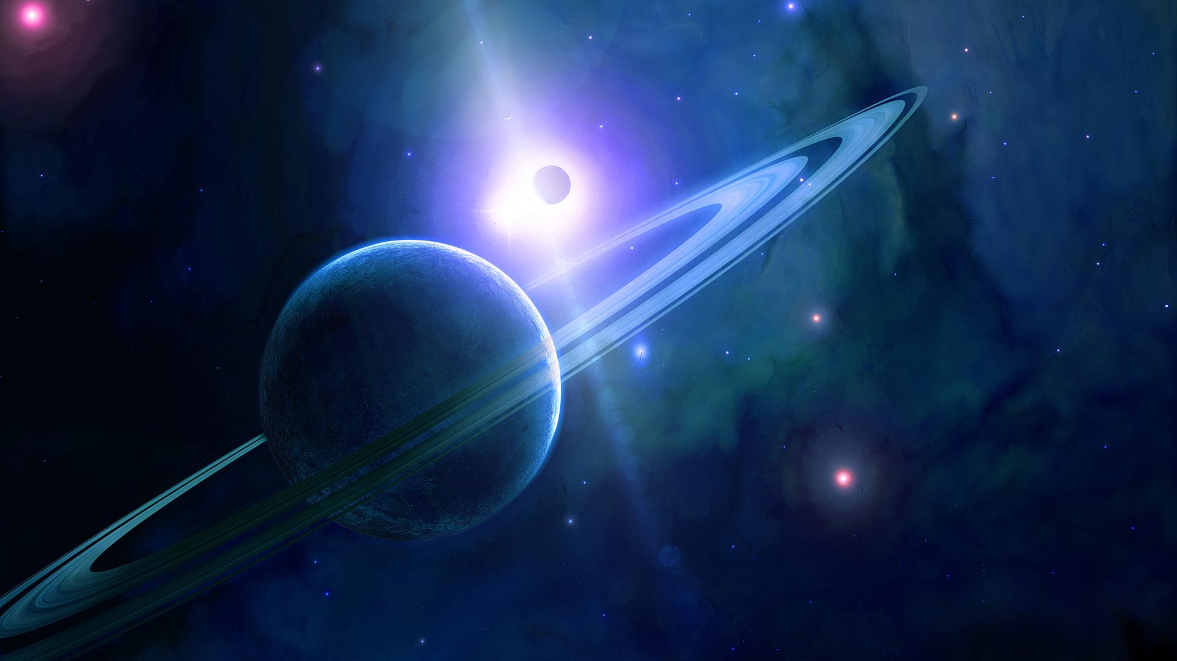
Neptune was first discovered in 1846
It takes nearly 165 years for Neptune to orbit the Sun – the longest orbit of all the planets
Neptune is 30 times further from the Sun than the Earth

Slide 7
Sources
https://theplanets.org/neptune/
http://www.arcadiastreet.com/cgvistas/neptune_0020.htm
http://space-kids.org/neptune/

