Slide 1
Jupiter
I chose Jupiter for my project because, it’s the largest planet in the solar-system and it is the fastest spinning to.
Size
Jupiter is 69,911km big and it weighs more than twice as much as all the other planets.
Temperature
Jupiter is five times as far from the Sun as the Earth, so its surface temperature is low, around –145°C.

Slide 2
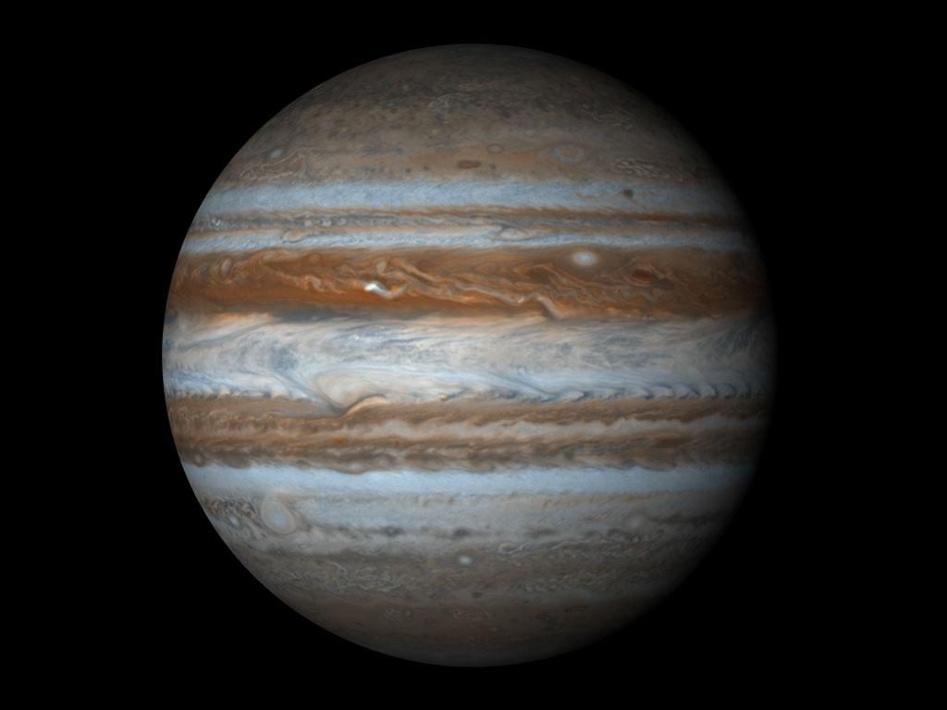
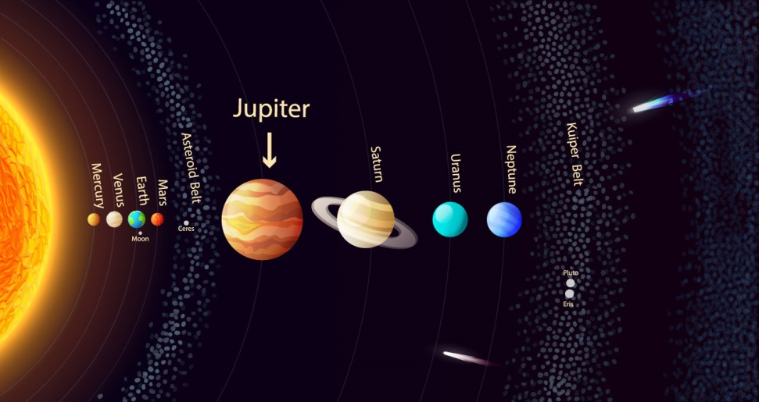
Pictures of Jupiter
This picture shows the size of jupiter compared to all the other planets.
This is jupiter,

Slide 3
The End
I found all my information on a website called ESA- space for kids (http://www.esa.int/esaKIDSen/SEM6JMMZCIE_OurUniverse_0.html)
I got my pictures from Google images.
Thanks for watching!!!!!
By Tyler Adams

